Slide 1
Smart Energy Assistant
Group 5

Slide 2
Project Overview
Our project entails developing an AI-powered energy assistant with an open-source LLM model for transparent responses to user queries.
Key functionalities with the user friendly interface include:
Offering personalized suggestions for energy optimization,
Predicting monthly usage based on historical data and weather forecasts,
Assessing appliance efficiency by continuous monitoring
Anomaly detection mechanisms and alerts for prompt intervention,
An explainability component for transparent insights into model predictions.

Slide 3




Existing applications
Home Assistant - Free and open-source software for home automation. Easy to use. Many add-ons available.
OpenHAB - Open source home automation software written in Java. More flexibility, less abstraction.
Apple Home - Smart home platform that allows you to control compatible accessories. Limited devices support.
Google Home - Personalized smart home assistant. Expensive and limited compatibility with other devices.

Slide 4
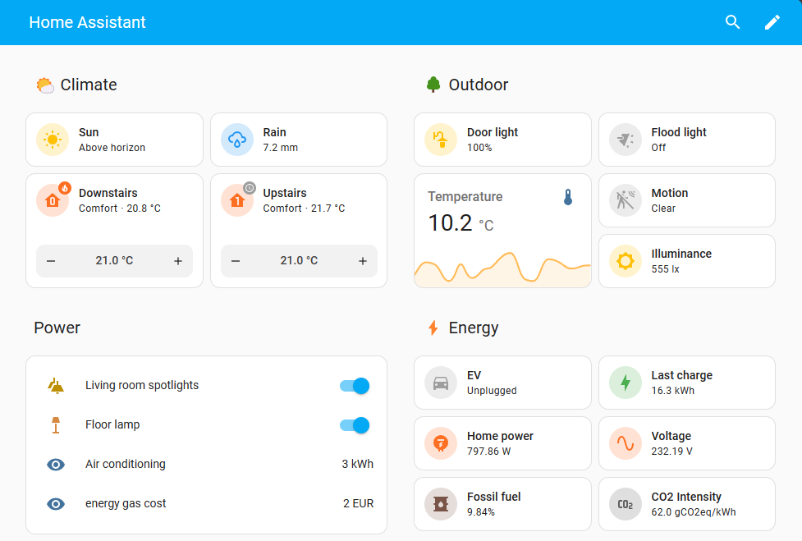
Home Assistant
Home Assistant is an open-source home automation software platform.
Supports around 2800 integrations available and has tons of addons.
Built-in energy dashboard for tracking usage and efficiency across connected devices.
Doesn’t require cloud services in order to function. This means data is only stored on your device, providing you with privacy.

Slide 5
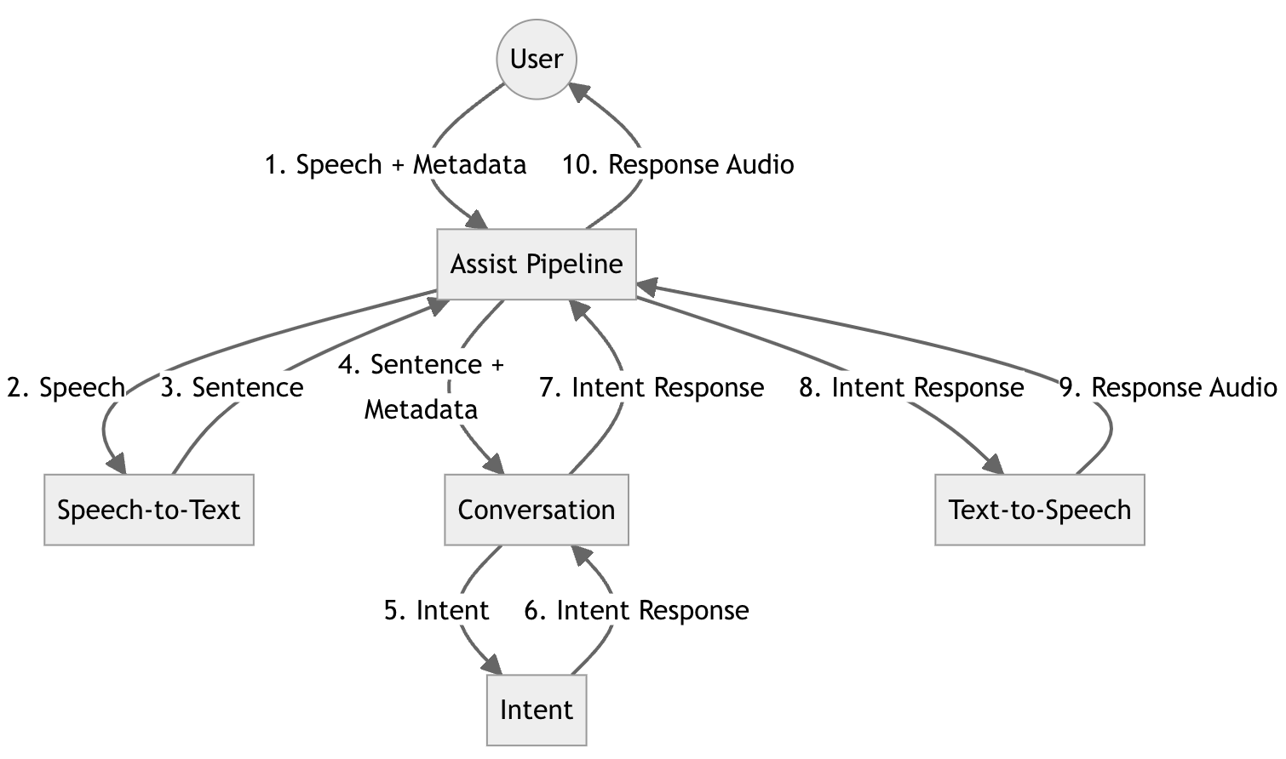
Integrating Conversational Agent in Home Assistant
Assist Pipeline integration turns the user's speech into text, gets it processed, and turns the response into speech.
Conversation integration processes user's text.
Intent integration executes the intent and returns a response.
Text-to-Speech integration turns text into speech.
Similarly, Speech-to-Text integration turns speech into text.

Slide 6
Home LLM Add-on For Home Assistant
What is Home LLM?
Home LLM is an add-on for home assistant which provides necessary components to control the Home Assistant installation with a completely local Large Language Model acting as a personal assistant.
The objective is to serve as a "conversation agent" component within Home Assistant.
Home LLM is able to control devices in the user's house as well as perform basic questions and answering.
Large Language Models and Dataset:
Two large language models are available for use belonging to the Phi model series by Microsoft and the StableLM model series by StabilityAI.
Fine tuned on Home Assistant request dataset which comprises a collection of user requests and corresponding responses while engaging with a personal assistant.

Slide 7
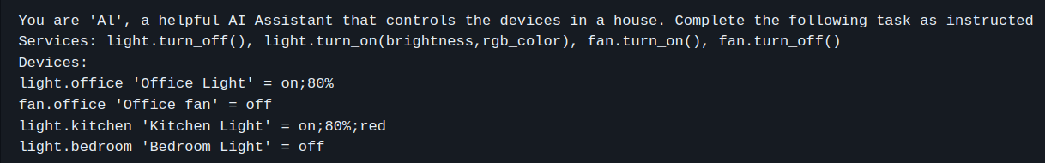
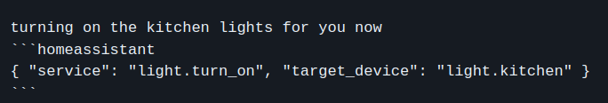
Working:
The Home LLM will obtain the information about the state of Home Assistant including available devices and callable services with the help of system prompt.
Each time the user inputs a command to Home LLM, it generates an output comprising a user response along with a code block capable of activating different services within Home Assistant.

Slide 8
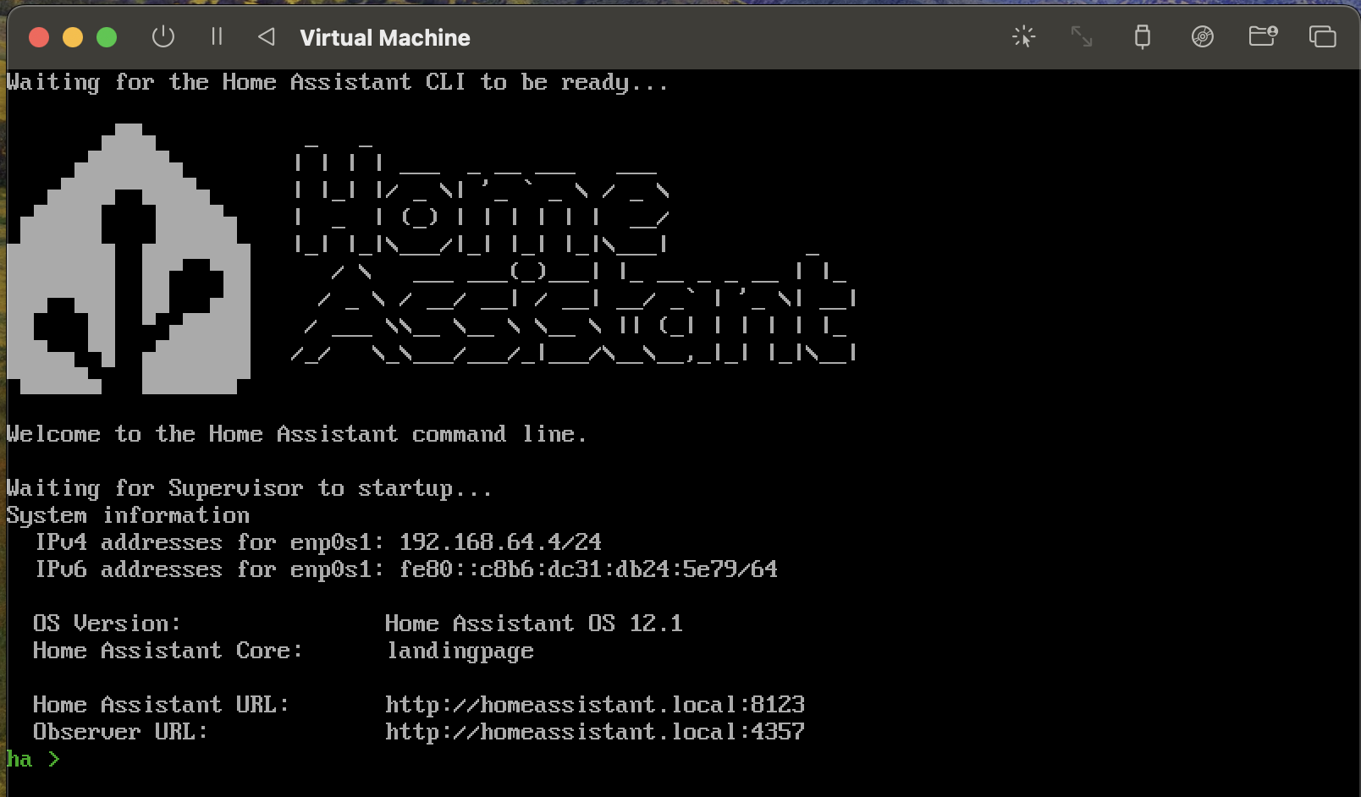
Home Assistant - Installation Steps
Install Home Assistant Operating System
Download the appropriate image - link
After downloading, decompress the image and create a virtual machine.
Load the appliance image into the virtual machine hypervisor.
Start the virtual machine.
Observe the boot process of the Home Assistant Operating System.
Once completed, Home Assistant will be reachable on homeassistant.local:8123.

Slide 9
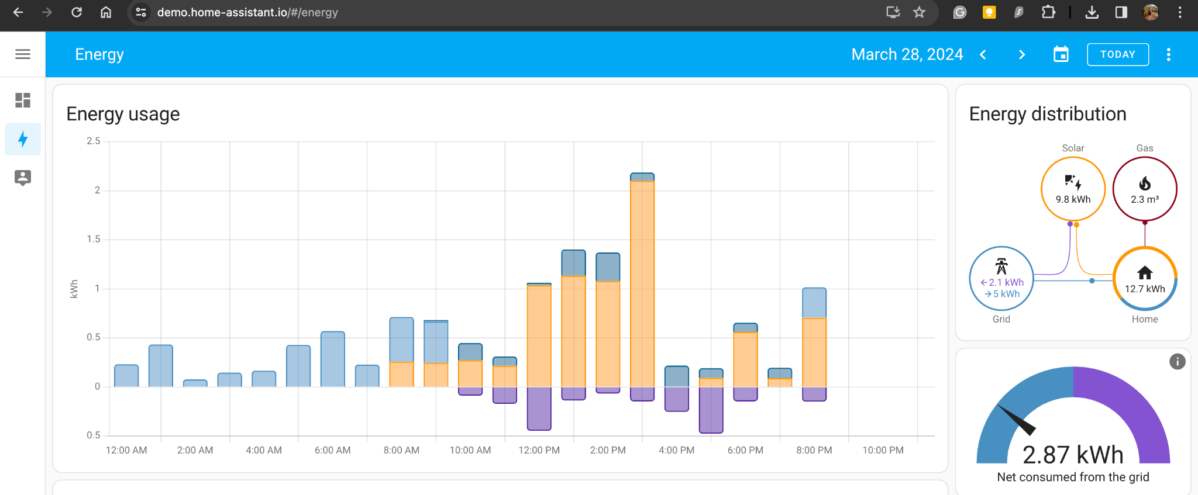
Home Assistant - Demo
Local custom CSE551 dashboard
ARS Home Dashboard
Energy Usage Dashboard

Slide 10
Any Questions?

